Slide 1
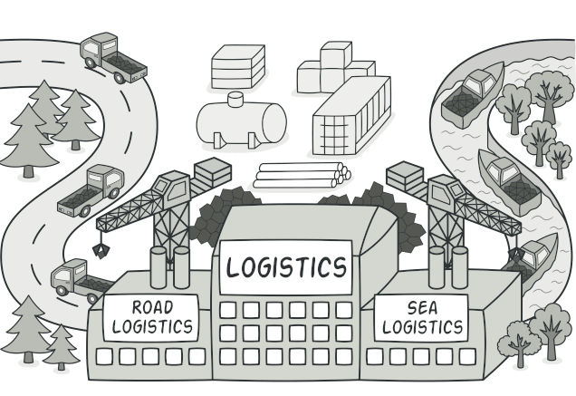
FACTORY DESIGN PATTERN
By : Ahmad Ridwan

Slide 2
Description
Design patterns are typical solutions to common problems in software design. Each pattern is like a blueprint that you can customize to solve a particular design problem in your code.
Creational patterns provide object creation mechanisms that increase flexibility and reuse of existing code.
Structural patterns explain how to assemble objects and classes into larger structures, while keeping these structures flexible and efficient.
Behavioral patterns take care of effective communication and the assignment of responsibilities between objects.

Slide 3
Description
Factory Method is a creational design pattern that provides an interface for creating objects in a superclass, but allows subclasses to alter the type of objects that will be created.

Slide 4
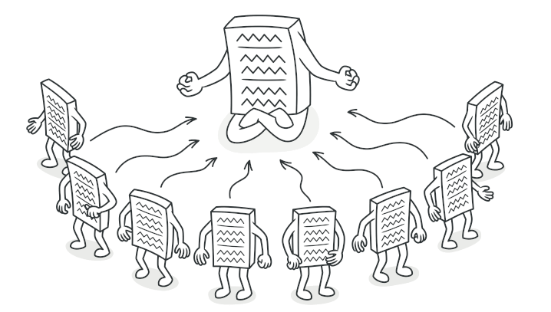
Perbedaan (Creational Pattern)
Singleton pattern : pembuatan hanya satu instance dari sebuah kelas

Slide 5
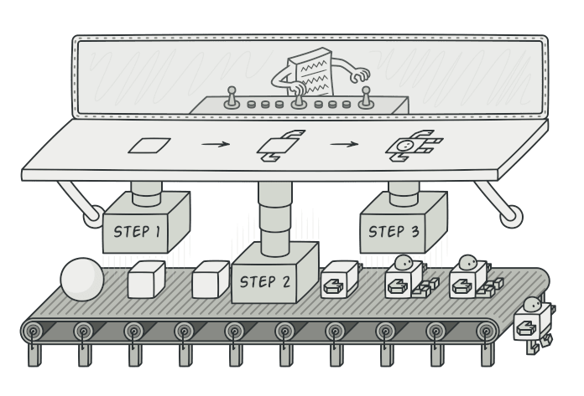
Perbedaan (Creational Pattern)
Builder pattern --> pembuatan objek yang kompleks dengan properti yang banyak

Slide 6
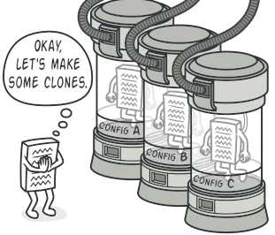
Perbedaan (Creational Pattern)
Prototype pattern pembuatan objek baru berdasarkan objek yang sudah ada.

Slide 7
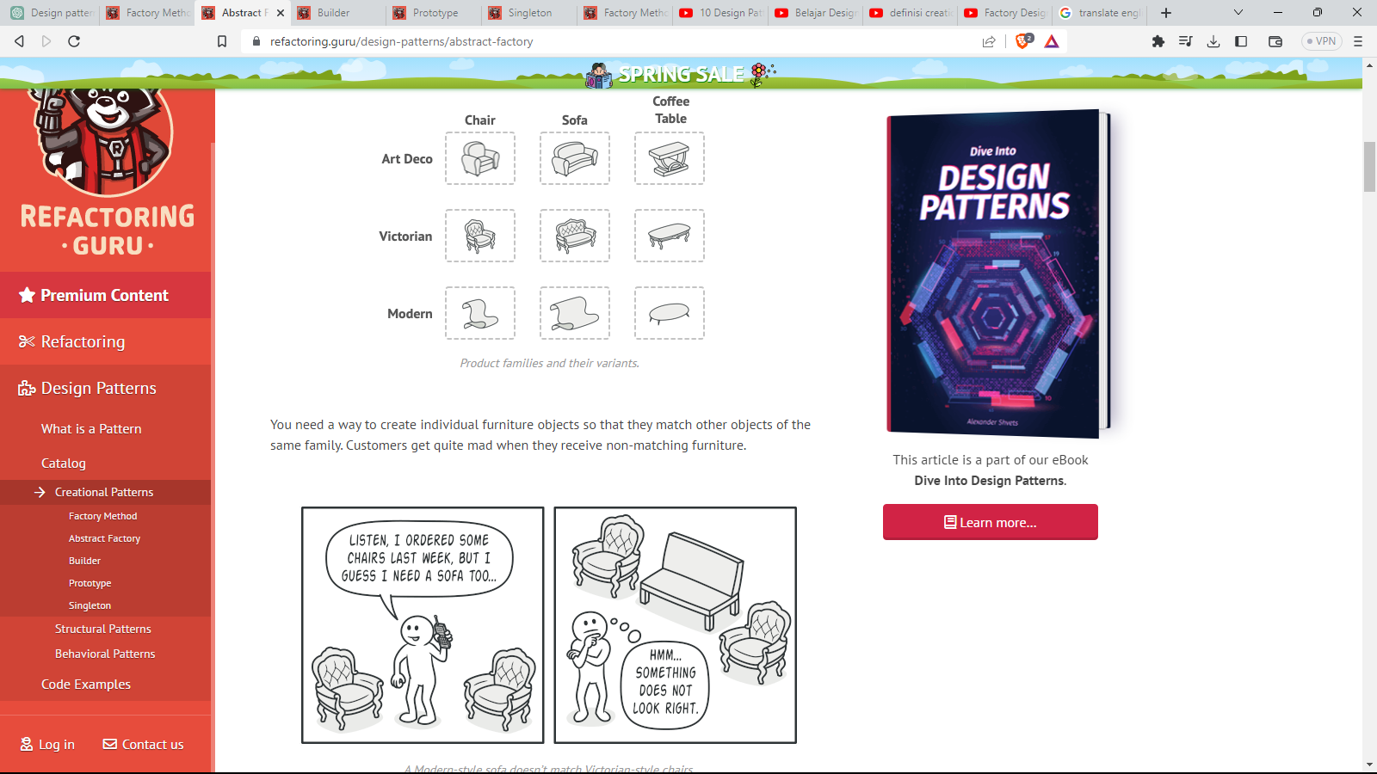
Perbedaan (Creational Pattern)
Abstract Factory Pattern menyediakan cara untuk membuat kelompok objek yang berkaitan atau tergantung satu sama lain

Slide 8
Kapan Memakai Factory Pattern
Ketika klien membutuhkan objek dari beberapa kelas yang berbeda tetapi tidak ingin tergantung pada kelas konkret dari objek yang dibuat.
Ketika kelas-kelas yang dibuat dalam aplikasi sangat kompleks dan memerlukan banyak logika untuk membuat objeknya.
Ketika dirasa akan memperluas jenis objek yang dapat dibuat dengan menambahkan kelas-kelas baru.
Ketika ingin memastikan bahwa proses pembuatan objek tidak terlihat oleh klien, sehingga mengurangi kompleksitas kode.

Slide 9
Pros cons
You avoid tight coupling between the creator and the concrete products.
Single Responsibility Principle. You can move the product creation code into one place in the program, making the code easier to support.
Open/Closed Principle. You can introduce new types of products into the program without breaking existing client code.
The code may become more complicated since you need to introduce a lot of new subclasses to implement the pattern.

Slide 10
Relations with Other Patterns
You can use Factory Method along with Iterator to let collection subclasses return different types of iterators that are compatible with the collections.

Slide 11
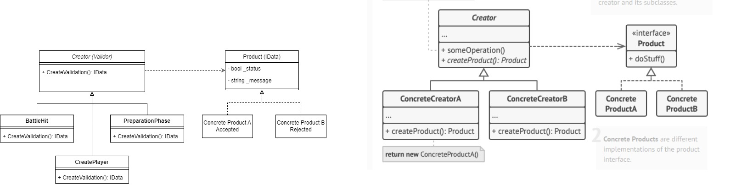
Contoh Penerapan

Slide 12


